Slide 1

Prediction of water/Temperature indices for sake of limiting the environmental injustice
Team Name: People.ai
Mohammad Nour Albaarini
Haitham Mahmoud
Zaid Gubran

Slide 2
Environmental Injustice & Motivation
Environmental injustice occurs when certain communities experience a disproportionate burden of environmental challenges such as exposure to air pollution, contaminated water, habitat loss, and disrupted livelihood due to natural hazards and climate change.
-- --- -- --- -- --- -- --- -- ---
We are experiencing a rise in global temperatures, with nineteen of the past twenty years being the warmest on record since 1880.
The U.S. Pacific Northwest recently experienced an extreme heat wave unlike any other in modern history.
Anthropogenic, or human-caused climate change is resulting in extreme weather events, drought, and other environmental challenges around the globe.
Around the world, we can see increasing examples of environmental injustices, particularly related to the management and access to water resources. It is estimated that over 2 billion people lack access to safe drinking water.
Reference: (https://appliedsciences.nasa.gov/our-impact/story/environmental-justice-call-action-nasa-earth-observations).

Slide 3
Our Solution
Ph
Hardness
Solid coefficient
Sulphate
Chloramines
Conductivity
Organic Carbon
Trihalomethanes
Turbidity
Water index prediction considered input data
Sensor #1
Input data
Whether water is safe to drink
0 or 1
Sensor #2
Water Index Prediction Model using Machine learning
…
Sensor #2
Temperature Tables
Input data
Whether is it safe to walk out
between 0 - 1
Air Temp. Index Prediction Model using Machine learning
Climate Change Param.

Slide 4
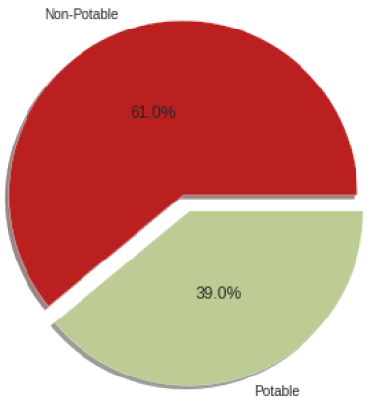
Case Study #1: Water Index Prediction Model
60% of the dataset is used as training data, and 40% as testing.
The used algorithms are: Random Forest, decision tree, KNN, SVM, logistic regression, and XGBoost.
The findings demonstrate that SVM beats the other methods by around 64% accuracy and 65% precision.
Not Safe to drink
Safe to drink

Slide 5
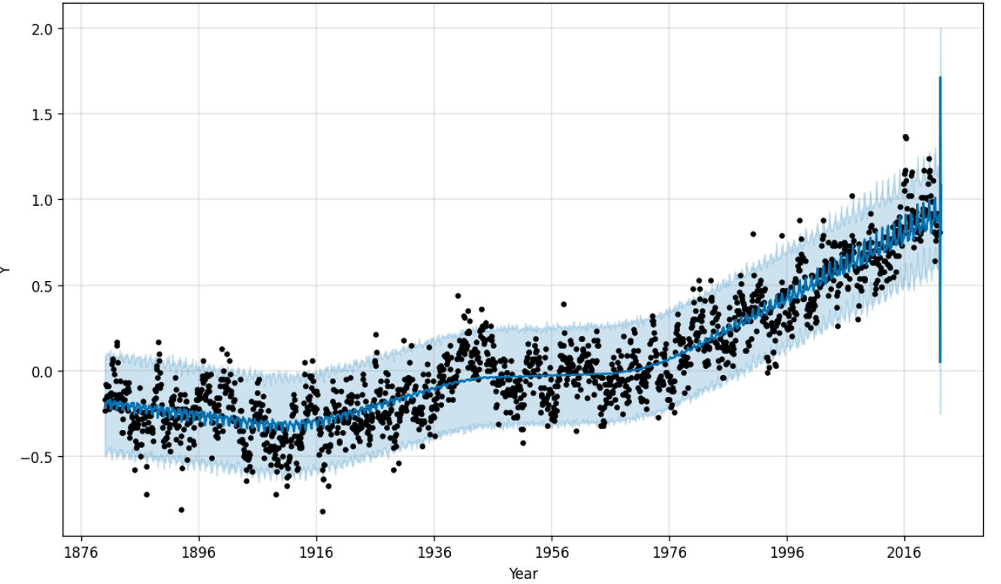
Case Study #2: Air Temperature Index Prediction Model
60% of the dataset is used as training data, and 40% as testing. A profit model is used.
The system generates an indicator that displays the temperature difference from the baseline temperature based on learning the temperature's behaviour throughout the period of the year.
A positive index indicates the observed temperature was warmer than the baseline, while a negative index indicates the observed temperature was cooler than the baseline
Air Temperature Index
Year

Slide 6
Conclusion
We developed two case studies in order to alleviate human suffering as a result of environmental injustice.
The first case study generates an index that indicates whether or not the transferred water is safe to drink.
The second case study aims to create an index that indicates whether or not it is safe for humans to go outside. This concept could be expanded to include other solutions to environmental injustice.

